Slide 1
ENGINEERING CHEMISTRY

Slide 2
ELECTRO CHEMSITRY

Slide 3
CONCEPT OF ELECTROCHEMISTRY
Electrochemistry is the study of chemical application.
Electrochemistry deals with the interactions between electrical energy and chemical energy.
These interactions are of two types
Conversion of electrical energy into chemical energy
Conversion of chemical energy into electrical energy

Slide 4
Electrical Conductors: Substances which allows electric current through it.
Ex: Metals, graphite,fused salts,aqueous solutions of acids, bases & salts.
Types of conductors
1)electronic conductors
2)electrolytic conductors
Non conductors or Insulators: Substances which does not allows electric current through it.
Ex: Rubber, paper ,dry wood ,etc

Slide 5
METALLIC CONDUCTORS:
Metallic conductors conduct electricity due to the movement of electrons from one end to another end.
In a solid, the electrical conduction involves the free movement of electrons in the metallic lattice, without any movement of the lattice atom; this type of conduction is called metallic conduction.
In metallic conductors, the electricity is carried by the electrons, the atomic nuclei remaining stationary.
:
These conductors are further sub classified in to three types.
A. Good conductor
B. Semi- conductor
C. Non- conductor or Insulator

Slide 6

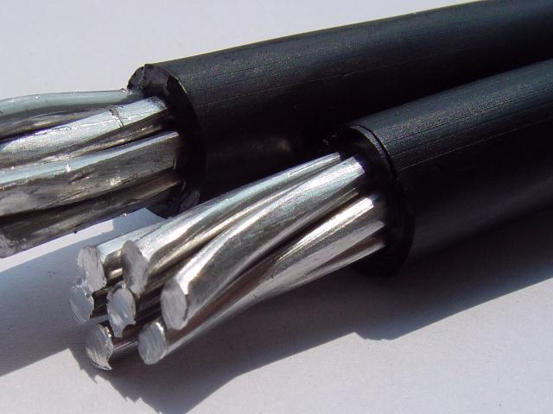
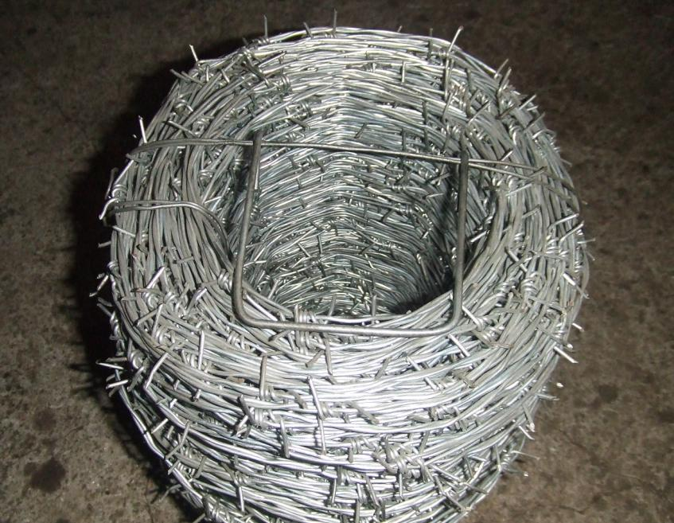
Good conductor:
It is a substance, which conducts electricity fully and freely.
EX: Metals like Copper, Aluminum, and Iron.

Slide 7
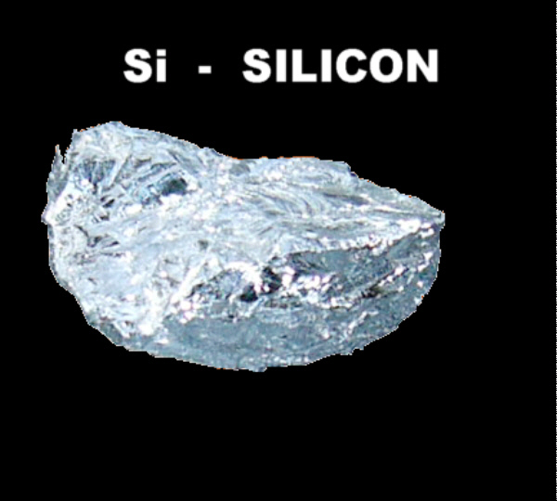
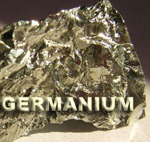
Semi- conductor:
It is a substance, which partially conducts electricity.
EX: Silicon, Germanium.

Slide 8
Electrolytic conductors
Substances in their fused form or in aqueous form allow the passage of current undergoing a simultaneous chemical transformation are called electrolytes and the conduction as the electrolytic conductance
Reciprocal of resistance is called as conductance
C = 1/ R Units = mho
Resistance (R) of a conductor is directly proportional to it’s length (l)& inversely proportional to area of cross section (a) Rαl/a

Slide 9
Difference between metallic and electrolytic conductors
Metallic conductors
1. Conductance is due to the flow of electrons.
2. It does not result any chemical change.
3. Metallic conduction decreases with increase in temperature.
4. It does not involve any transfer of matter
Electrolytic conductors:
1. Conductance is due to the movement of ions in a solution.
2. Chemical reactions take place at the electrodes.
3. Electrolytic conduction increases with increase in temperature.
4. It involves transfer of matter.

Slide 10



Specific conductance: Specific conductance is the conductance of all the ions that are present in 1 ml solution.
Units; ohm⁻¹cm⁻¹
.
Equivalent conductance: Equivalent conductance is the conductance of total ions present in a solution containing 1 g equivalent of electrolyte.
=
    Units:ohm⁻¹cm²equiv⁻¹
^v =

Slide 11


Molar conductance: Molar conductance is the conductance of all the ions of 1 mole of electrolyte present in a solution.
Units: = ohm⁻¹cm²mole⁻¹

Slide 12
EFFECT OF DILUTION:
Generally conductance depends on three factors 1.number of ions
2.charge of ions
3.mobilityof ions
As the dilution increases more, the electrolyte ionises more &specific conductance decreases.
Equivalent &Molar conductance increases with dilution

Slide 13
ELECTROMOTIVE FORCE
Electromotive Force is the difference of potential, which causes the current to flow from an electrode at higher potential to the one of lower potential.
E_{cell} = E_{(right)} - E_{(left)}
E_{cell} EMF of the cell.
E_{right} reduction potential of right hand side electrode.
E_{left} reduction potential of left hand side electrode.

Slide 14
Applications of EMF measurement:-
1.Potentiometric titrations can be carried out.
2. Transport number of ions can be determined.
3. P^{H} can be measured.
4. Hydrolysis const. can be determined.
5. Solubility of sparingly soluble salts can be found.

Slide 15
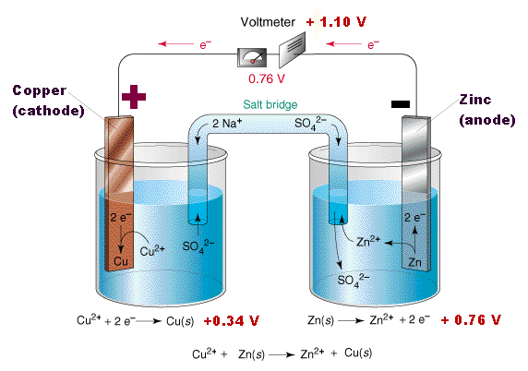
GALVANIC CELL
It is a cell in which chemical energy is converted to electrical energy.
This cell consists of two half cells
1)Anodic half cell
2)Cathodic half cell
At anodic half cell, oxidation takes place
At cathodic half cell, reduction takes place

Slide 16
The following reactions take place in the cell.
At Anode:
Zn → Zn⁺² + 2e⁻ (oxidation or de-elecronation)
At cathode:
Cu⁺² + 2e⁻ → Cu ( Reduction or electronatioin)
The movement of electrons from Zn to cu produces a current in the circuit.
The overall cell reaction is: Zn +Cu⁺² → Zn⁺² +Cu
The galvanic cell can be represented by Zn/znso₄//cuso₄/cu

Slide 17
REFERENCE ELECTRODES
An electrode of known potential is called reference electrode.
Hydrogen electrode is the earliest primary reference electrode.
The secondary reference electrodes discussed here are
1)Calomel electrode
2)Quinhydrone electrode

Slide 18
Types of electrodes
Primary & secondary reference electrodes :
Standard hydrogen electrode(SHE):It is a primary reference electrode. The emf of such a cell is arbitrarily been fixed as zero.
construction:
It consists of a small platinum electrode coated with platinum black immersed in a 1M solution of H⁺ ions maintained at 25⁰c.
Hydrogen gas at one atmosphere pressure enters the glass hood and bubbles over the platinum electrode.
The H₂ gas at the platinum electrode passes into the solution forming H⁺ ions & electrons. H₂→2H⁺ +2e⁻

Slide 19
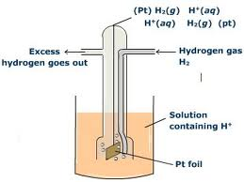
By convention the standard electrode potential of hydrogen electrode when the hydrogen gas passed at one atmosphere pressure is bubbled through a solution of hydrogen ions of unit concentration is orbitarily fixed as zero.
Nernst equation:
At latm
E_{pt,}H_{2/}H⁺ = E⁰_{pt,}H_{2/H+}- 0.059
=E⁰_{pt,} H₂/H⁺ + 0.059 p^{H}
log a_{H+}

Slide 20
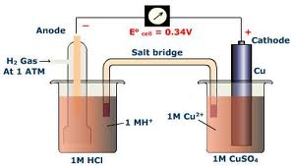
Depending on a half cell to which it is attached hydrogen electrode can act as a cathode or an anode.
But in the given figure hydrogen electrode is connected to copper electrode & it act as anode ,when it is acting as anode ,oxidation takes place.
1/2H₂(g)(1atm)→ H⁺ (1M)+e

Slide 21
Calomel electrode
The calomel electrode consists of a glass tube having two side tubes. A small quantity of pure mercury is placed at the bottom of the vessel and is covered with a paste of Hg and Hg₂ Cl₂.
KCl solution of known concentration is filled through side tube, Shown on the right side of the vessel.
The KCl sol. is filled in the left side tube which helps to make a connection through a salt bridge with the other electrode, which potential has to be determined.
A ‘pt’ wire is sealed into a glass tube as shown in the fig which is in contact with Hg.
When the cell is set up it is immersed in the given solution.

Slide 22
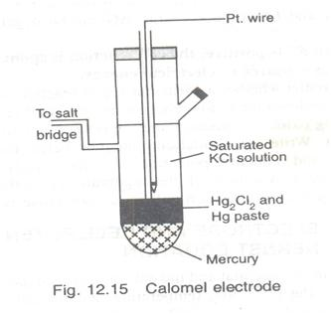
The electrode potentials of calomel electrode of different concentrations at 25⁰c are
0.1 M KCl/ Hg₂cl₂ (s) / Hg,pt → 0.33v
1M KCl / H g₂cl₂ (s) / Hg,pt
→
0.28v
Saturated kcl /Hg₂ cl₂ (s) /Hg, pt
→
0.24v
The corresponding electrode reaction is
Hg₂ Cl₂ + 2e⁻ →
2Hg + 2cl⁻

Slide 23
Glass electrode
Glass electrode is one of the type of ion selective electrode. (ISE). It is is made up of glass tube ended with small glass bulb sensitive to protons.
Glass electrode
The tube has strong and thick walls and the bulb is made as thin as possible.
Inside of the electrode is usually filled with buffered solution of chlorides in which silver wire is covered with AgCl is immersed. The pH of internal solution can be varies.
In this electrode, active part of electrode is the glass bulb. The surface of the glass is protonated by both internal and external solution till equilibrium is achieved.

Slide 24
Both sides of the glass are changed by the absorbed protons. And this charge is responsible for potential difference.
This potential is directly proportional to the pH difference between the solutions on both sides of the glass.
Glass electrode work in the pH range of 1-12 the glass electrode may be represented as
Ag, AgCl/ Hcl (0.1N) / glass / H⁺ (unknown)
Here Ag/AgCl acts as internal reference electrode.

Slide 25
Glass electrode diagram

Slide 26


Nernst equation
Nernst studied the theoretical relationship between electrode reaction and the corresponding cell e.m.f. This relationship generally Known as Nernst equation.
Consider a galvanic cell aA + bB → cC + dD.
Where a,b,c,d represents no. of moles respectively at equilibrium.
The Nernst eq’ for the cell is written as
-

Slide 27


- 2.303
In the above eq’ R= 8.314 J/K. T=298K, F=96, 500 columbs.
By substituting the values in the eq’
- 0.0591
Applications: 1.It can be used to study the effect of electrolyte concentration on electrode potential. 2.the ph of the solution can be calculated from the measurement of emf and Nernst equation. 3.Nernst equation can also be used for finding the valency of an ions or the number of electrons involved in the electrode reaction

Slide 28
Electrochemical series
When the metals are arranged in the order of increasing reduction potentials or decreasing oxidation potentials which are determined with respect to one molar solutions of their ions and measured on the hydrogen scale, along series or list, resulted is called electrochemical or galvanic series.
The higher a metal is in the series, the greater is its tendency to be oxidized.
Applications : 1. relative corrosion tendencies of the metals& alloys.
2.relative ease of oxidation or reduction of metals. 3.replacement tendency of metals.

Slide 29
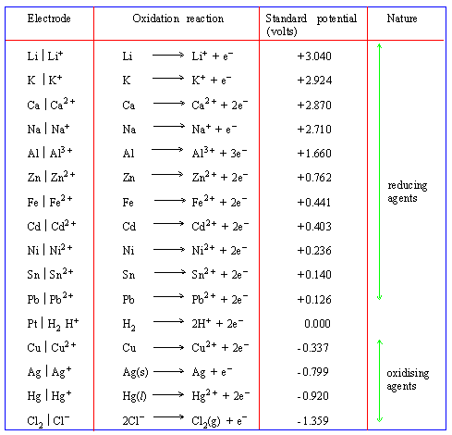
STANDARD REDUCTION POTENTIAL

Slide 30
Batteries & Fuel Cells
A history in pictures

Slide 31

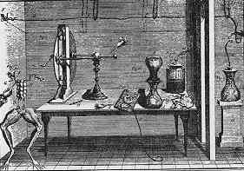

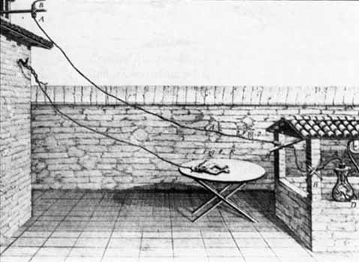
1771-1800: The Galvani-Volta Controversy
Luigi Galvani “Animal Electricity
Alessandro Volta

Slide 32

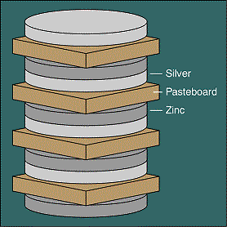
1800: The First Battery (Voltaic Pile)
1801: Volta presenting his battery to Napoleon

Slide 33


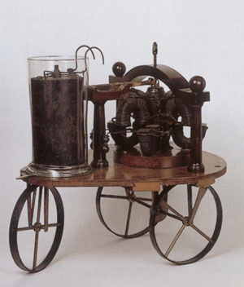
1821: The First Electric Motor
1835: The First BEV (Battery Electric Vehicle)
Michael Faraday
Sibrandus Stratingh

Slide 34
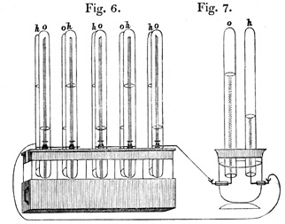

1839: First Fuel Cell (Grove’s “Gas Battery”)
Sir William Grove

Slide 35

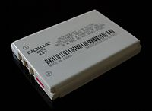

Slide 36
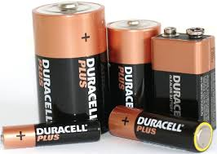

BATTERIES
They are electrochemical cells connected in series
Batteries are Store houses of electrical energy
They are used as a source of direct electric current at constant voltage.
They are classified into two types
i) Primary cell
ii) Secondary cell

Slide 37
Primary Batteries: These are non rechargeable & are meant for single use& discarded after use.
Secondary Batteries: Voltaic cells whose electrochemical reactions can be reversed by a current of electrons running through the battery after the discharge of an electrical current.
A secondary battery can be restored to nearly the same voltage after a power discharge.

Slide 38
Differences between Primary and secondary batteries:
Primary cells | Secondary cells
These are non-rechargeable and meant for a single use and to be discarded after use. Cell reaction is not reversible. Cannot be rechargeable. Less expensive. Can be used as long as the materials are active in their composition. Eg: Leclanche cell, ‘Li’ Cells. | These are rechargeable and meant for multi cycle use. Cell reaction can be reversed. Can be rechargeable. expensive. Can be used again and again by recharging the cell. Eg; Lead- acid cell, Ni-cd cells.

Slide 39
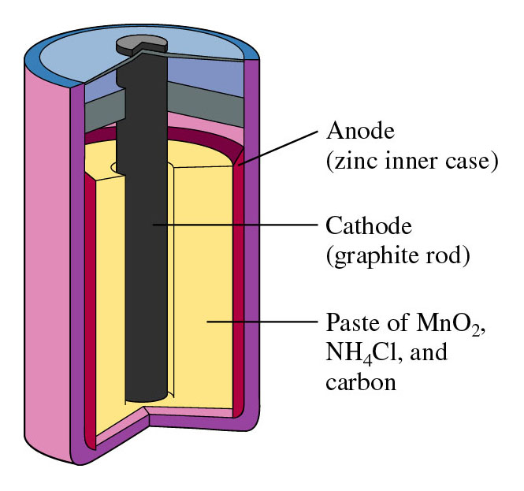
PRIMARY CELL OR LECLANCHE CELL
In this cell the reactions are irreversible
It is also known as Dry cell
Anode- Zinc container
Cathode- Carbon rod
Anode reaction
Zn→ Zn²⁺+2e⁻
Cathode reaction
2NH⁴⁺+2MnO₂+2e⁻ → Mn₂O₃+2NH₃+H₂O
Cell reaction
2MnO₂+2NH₄Cl+Zn→ Zn(NH₃)₂Cl₂ + Mn₂O₃
+H₂O

Slide 40
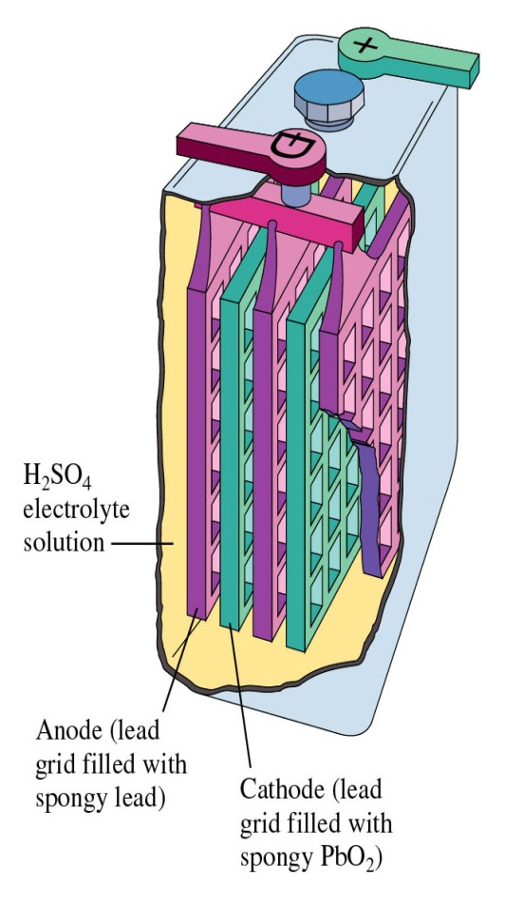
Lead Storage battery
Anode reaction
Pb+HSO₄⁻→ PbSO₄+H⁺+2e-
Cathode reaction
PbO₂+HSO₄⁻+3H⁺+2e⁻ → PbSO₄+2H₂O
Cell reaction
Pb+PbO₂+ 2H⁺+2HSO₄⁻→ 2PbSO₄+2H₂O

Slide 41
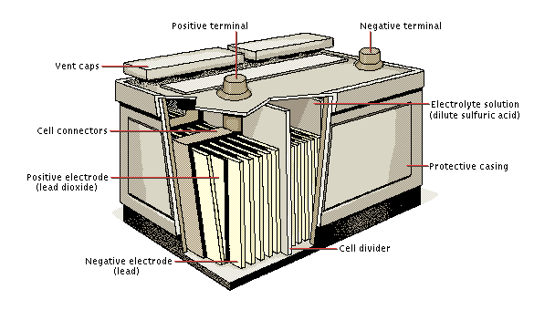
Pb +PbO₂ +H₂SO₄ →PbSO₄(s)+H₂O
Lead Acid Recharging
Low self-discharge
  40% in one year (three months for Ni-Cd)
No memory
Cannot be stored when discharged
Limited number of full discharges
Danger of overheating during charging

Slide 42
Applications
1.Automobile and construction equipment.
2. Standby / backup system.
3. For engine batteries
Advantages:-
Low cost, long life cycle, Ability to withstand mistreatment, perform well in high and low temperature.

Slide 43
4. Lithium-ion battery (Li-ion Battery)
Li-ion batteries are secondary batteries.
The battery consists of a anode of Lithium, dissolved as ions, into a carbon.
The cathode material is made up from Lithium liberating compounds, typically the three electro-active oxide materials,
  Lithium Cobalt-oxide (LiCoO₂ )
  Lithium Manganese-oxide (LiMn₂ O₄ )
  Lithium Nickel-oxide (LiNiO₂)

Slide 44
Principle
During the charge and discharge processes, lithium ions are inserted or extracted from interstitial space between atomic layers within the active material of the battery.
Simply, the Li-ion is transfers between anode and cathode through lithium Electrolyte.
Since neither the anode nor the cathode materials essentially change, the operation is safer than that of a Lithium metal battery.
The chemical reaction that takes place inside the battery is as follows, during charge and discharge operation:

Slide 45
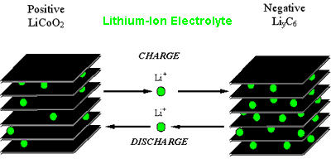
Li- ion Electrolyte
Li-Ion battery Principle

Slide 46
Advantages
They have high energy density than other rechargeable batteries
They are less weight
They produce high voltage out about 4 V as compared with other batteries.
They have improved safety, i.e. more resistance to over voltage. No liquid electrolyte means they are immune from leaking. .
Fast charge and discharge rate
Disadvantage
They are expensive
They are not available in standard cell types.

Slide 47
Applications
The Li-ion batteries are used in cameras, calculators
They are used in cardiac pacemakers and other implantable device
They are used in telecommunication equipment, instruments, portable radios and TVs, pagers
They are used to operate laptop computers and mobile phones and aerospace application

Slide 48
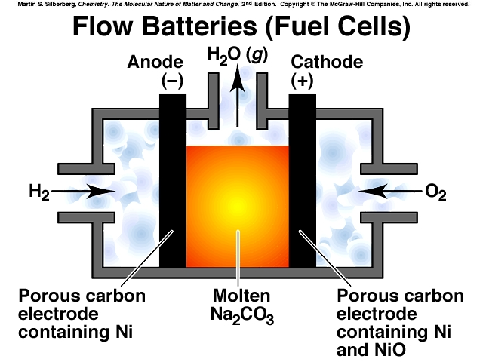

Slide 49
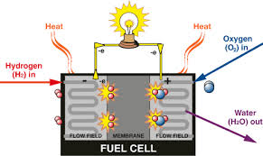
FUEL CELLS
The cell that converts energy of combustion of fuels like Hydrogen, Methane to electrical energy. Fuels are usually gas or liquid, with oxygen as the oxidant..…
Different fuel cells are The direct conversion of chemical energy to electrical energy has 100%.
The cell representation is as follows. Fuel/electrode//electrolyte//electrode//oxidant
Types of Fuels:
1.Hydrogen – Oxygen Fuel cell
2.Methanol –Oxygen fuel cell

Slide 50
LIMITATIONS OF FUEL CELLS
Large weight and volume of hydrogen gas fuel storage system
High cost of Hydrogen gas, technological advances should bring the cost down
Lack of infrastructure for distribution and marketing of Hydrogen gas.
Most basic fuel cells suffer from carbon di oxide leakages and should be prevented from entering the cell and reacting with the electrolyte.

Slide 51
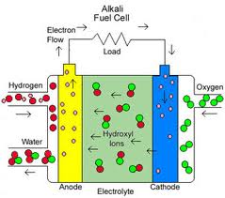
Hydrogen-Oxygen or Alkaline fuel cell
In this fuel cell, electrolyte is 25-30% aqueous KOH.This cell make use of high purity of hydrogen as fuel &oxygen as oxidant.
The reaction between H₂-O₂ takes place to produce water &excess electrons produces the electric current.

Slide 52
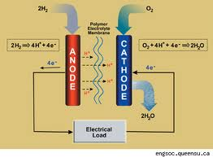
Reactions: At anode:2H₂+4OH⁻ → 4H₂O+4e⁻
At cathode: O₂+2H₂O +4e⁻ → 4OH⁻
Net reaction: 2H₂+O₂ → 2H₂O
The product discharged is water &standard emf is 1.23volts.
Applications:
  1.These are used as auxillary energy source in space, vehicles, submarines & military vehicles.
  2.The product in this cell is water &it is used as valuable fresh water &source for astronauts.

Slide 53
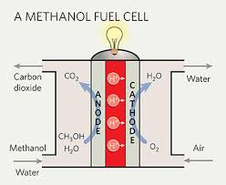
Methanol-oxygen fuel cell:
  In this cell, CH₃OH is used as a fuel & O₂ as a oxidant to generate electric current. This cell has two electrodes.
  porous nickel electrode coated with pt/pd catalyst act as anode & coated with silver catalyst act as cathode.
  The electrolyte KOH taken is in between two electrodes.

Slide 54
Reactions:
At anode:CH₃OH + 6OH⁻ → CO₂+5H₂O+6e⁻
At cathode:3/2O₂ + 3H₂O + 6e⁻ → 6OH⁻
Net reaction:CH₃OH +3/2O₂ → CO₂ +2H₂O
Advantages : 1.These cells are reasonably stable at all environmental conditions.
2.Easy to transport.
3.Do not require complex steam reforming operations.
4.Methanol posses less risk to aquatic plants, animals & human beings than gasoline.

Slide 55
Advantages of fuel cells
1.The reactants and products are environment friendly.
2.High efficiency of energy conversion from chemical energy to electrical energy.
3.The fuels and electrolyte materials are available in plenty and inexhaustible unlike fossil fuel.
4.Fuel cells are operatable to 200 degree centigrade and so finds applications in high temperature systems.
5.Fuel energy is economical and safe.
6.Fuel cells are compact & transportabe.

Slide 56


