Slide 1
Course: B.Tech.
Subject: Engineering Chemistry Unit: III

Slide 2
Definition: Basic concepts
Polymers: A polymer is a long molecule formed by joining together of thousands of small molecular units by chemical bonds.
Monomers: Small molecules which combine together to formpolymer molecules are known as Monomers.
Polymerization: The chemical process leading to the formation of polymer is known as Polymerization.
The number of monomeric units contained in the polymer is known as the Degree of Polymerization.

Slide 3
Classification of Polymerization
Addition polymerization / Chain polymerization
Condensation / Step polymerization

Slide 4
Addition / Chain polymerization
Addition is a reaction that yields a product, which is an exact multiple of the original monomeric molecule.
Addition polymerization is the joining together of two or more simple molecules, called Monomers, to form a new compound of the same empirical formula, called a polymer which has a very high molecular weight.

Slide 5
The polymers formed by addition polymerisation are thermoplastic.
These include
Polythene,
Polypropylene
Polystyrene

Slide 6
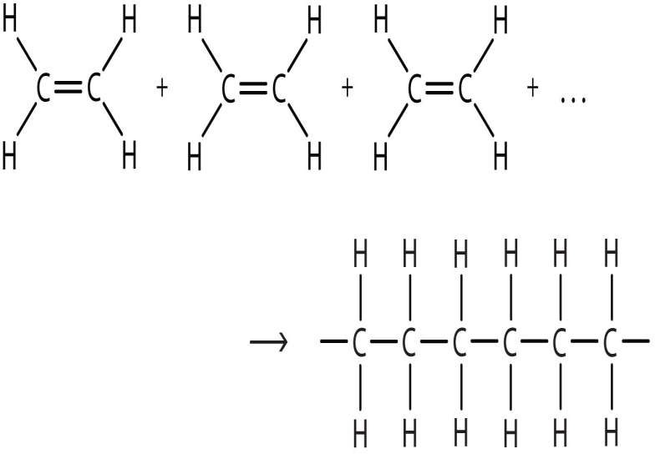
Example:Ethene to polythene
Ethene
Ethene
Ethene
Polyethene

Slide 7
Condensation/Step Polymerization
A reaction occurring between simple polar-group- containing monomers with the formation of polymer and elimination of small molecules like water ,HCl.
This may be defined as the process in which the monomer molecules of different compounds combine with the loss of some simple molecules, like water, or HCl.

Slide 8
This process can produce both thermoplastics and thermosetting plastics.
e.g. Polyesters
nylon are formed by this process.

Slide 9
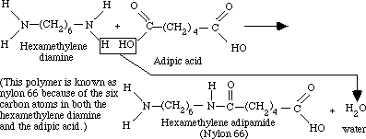
Example: Nylon 6:6
3

Slide 10
Copolymerization
Copolymerization is the joint polymerization of two or more monomer species.
High molecular weight compounds obtained by copolymerization are called Copolymers.

Slide 11
Example: Formation of SBR
4

Slide 12
Industrial applications of Polymerization
Acrylonitrile-butadiene-styrene (ABS): Refrigerator lining, lawn and garden equipment, toys
Acrylics:Lenses, transparent aircraft enclosures
Nylons: Bearings, gears
Polyethylene: Flexible bottles, toys, tumblers, battery parts, ice trays

Slide 13
References
1.Engineering chemistry by Jain and Jain 2.https://2012books.lardbucket.org 3.http://matse1.matse.illinois.edu/polymers/prin.html 4.https:// chem-guide.blogspot.com

