Slide 1
WATER TECHNOLOGY
Course: B.Tech Subject: Engineering Chemistry
Unit:4
1

Slide 2
Sources of Water
A) Surface Waters
Rain Water - Pure but contaminated with gases River Water - High dissolved salts moderate
organics
Lake Water - Const. composition but high organics Sea Water - High salinity, pathogens, organics
B) Underground Waters
Spring/Well Water - Crystal clear but high dissolved
salts and high purity from organics
2

Slide 3
MAJOR IMPURITIES OF WATER
Ionic and dissolved
Cationic Calcium Magnesium
Anionic Bicarbonate Carbonate Hydroxide
Nonionic and undissolved Turbidity, silt, mud, dirt and other suspended matter
Gases CO₂
H₂S NH₃ CH₄ O₂
Alkalinity
Sodium Potassium Ammonium Iron Manganese
Color, Plankton Organic matter,
Sulfate
Chloride Colloidal silica,
Nitrate
Phosphate
Microorganisms,
Bacteria
3

Slide 4
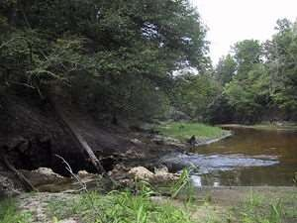
HARD WATER
Hardness refers to the presence of calcium and magnesium ions in water (and sometimes iron).
Ions come from dissolved rock the water has passed through.
Affects properties of tap
water
1

Slide 5
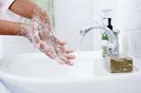
HARD WATER
Minerals in hard water interact with soap.
Interferes with soap’s ability to lather.
2

Slide 6
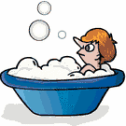
SOFT WATER
Water with very low concentrations of minerals.
Soap lathers easily and is sometimes difficult to rinse off.
3

Slide 7
HARDNESS OF WATER
Hardness in Water is characteristic that prevents the ‘lathering of soap’ thus water which does not produce lather with soap solution readily, but forms a white curd is called hard water.
Type of Hardness
Temporary or Carbonate Hardness
Permanent Hardness or non-carbonate Hardness.
7

Slide 8
Temporary Hardness
– Temporary Hardness is caused by the presence of dissolved bicarbonate of
calcium, magnesium and other heavy metals and the carbonate of iron.
It is mostly destroyed by more boiling of water, when bicarbonates are decomposed yielding insoluble carbonates.
Ca(HCO₃)₂ Heat CaCO₃ + H₂O + CO₂
Calcium bicarbonate Calcium Carbonate
Mg(HCO₃)₂ Heat Mg(OH)₂ + 2CO₂
Magnesium Bicarbonate Magnesium hydroxide
– Calcium/Magnesium Carbonates thus formed being almost insoluble, are
deposited as a scale at the bottom of vessel, while carbon dioxide escapes out.
8

Slide 9
PERMANENT HARDNESS
Non Carbonate Hardness is due to the presence of chlorides, sulfates of
calcium, Magnesium, iron and other heavy metals
2C₁₇H₃₅COONa + CaCl₂
(C₁₇H₃₅COO)₂Ca + 2NaCl
Calcium stearate (Insoluble)
Sodium stearate (sodium soap)
Hardness
2C₁₇H₃₅COONa + MgSO₄
(C₁₇H₃₅COO)₂Mg + 2Na₂SO₄
Magnesium stearate (Insoluble)
Sodium stearate (sodium soap)
Hardness
9

Slide 10
Draw backs (or) Disadvantages of Hard Water
Domestic Use
Industrial Use
Washing
Bathing
Drinking
Cooking
Textile Industry
Sugar Industry
Dyeing Industry
Paper Industry
Pharmaceutical Industry
In Steam generation in Boilers
The sticky precipitate adheres on the fabric/cloth and gives spots and streaks. Fe salts stain the cloths.
Produces sticky scum on the bath tub and
the body
Bad to the digestive system and calcium oxalate formation is possible in urinary tracts
Requires more fuel and time. Certains food don’t cook soft and also gives unpleasant taste
10

Slide 11
Boiler troubles due to Hard Water
1. Scale and Sludge
1. Sludge
Slimy loose precipitate called sludge suspended in water
2. Caustic embitterment
3. Priming and Foaming
4. Boiler corrosion
water
4
Boiler wall
Sludge is a soft, loose and slimy precipitate formed within the boiler. It can be easily scrapped off with a wire brush.
It is formed at comparatively colder portions of the boiler and collects in areas of the
system, where the flow rate is slow or at bends.
It is formed by substances which have greater solubility's in hot water than in cold water, e.g. MgCO₃, MgCl₂, CaCl₂, MgSO₄ etc.,
Remedy: Sludges can be removed using wire brush or mild acid
11

Slide 12
DISADVANTAGE OF SLUDGE FORMATION:
-poor conductor of heat
-disturbs the working of boiler.
- If along with scales : both get deposited as scales.
Preventation of Sludge formation:
Well softened water
Drawing off a portion of concentrated water.
12

Slide 13
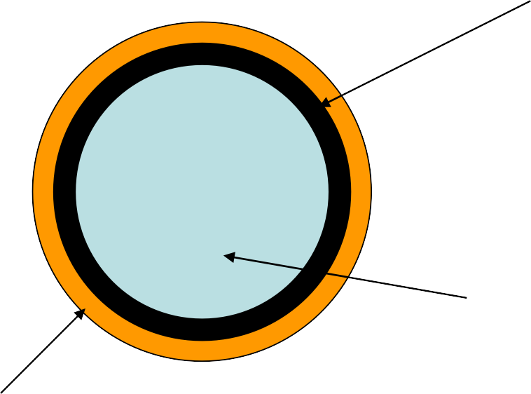
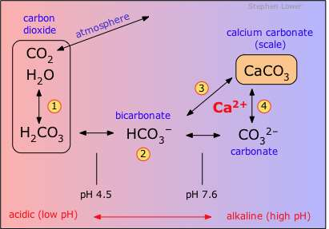
1. Scale
Hard adherent coating on inner walls of boiler
water
Boiler 6
wall
5
Scales are hard substances which sticks very firmly to the inner surfaces of the boiler wall.
Scales are difficult to remove even with the help of a hammer and chisel.
Examples: CaSO₄, CaCO₃, Mg(OH)₂
13

Slide 14
Reasons for formation of scale
1. Presence of Ca(HCO₃)₂ in low pressure boilers
Ca(HCO₃)₂ CaCO₃ + H₂O + CO₂
Calcium bicarbonate Calcium Carbonate (scale)
Low pressure boilers but in high pressure
boilers it is soluble by forming Ca(OH)₂
2. Presence of CaSO₄ in high pressure boilers
TºC Solubility of CaSO₄
15 3200 ppm
230 15 ppm
320 27 ppm
Cold water soluble
Super heated water Insoluble (scale)
4. Presence of SiO₂
It forms insoluble hard adherent CaSiO₃ and MgSiO₃ as scales
3. Presence of MgCl₂ in high temperature boilers
MgCl₂ + 2 H₂O
Magnesium chloride
Mg (OH)₂ + 2HCl
scale
Mg(OH)₂ can also be generated by thermally decomposing Mg(HCO₃)₂
14

Slide 15
Disadvantages of scale formation
Fuel wastage – scales have low thermal conductivity
Degradation of boiler material and increases of risk of accident
Reduces the efficiency of the boiler and- deposit on the valves and condensers
The boiler may explode – if crack occurs in scale
Remedies: Removal of scale
Using scrapper, wire brush often
By thermal shock- heating and cooling suddenly with cold water
Using chemicals – 5-10% HCl and by adding EDTA
15

Slide 16
Prevention of scale formation
Scale formation can be prevented by two methods
Internal conditioning or Internal Treatment
External conditioning or External treatment- will be discussed later
1. Internal conditioning methods - of boiler water to prevent scale formation
Phosphate conditioning – addition of phosphate compound
Carbonate conditioning – addition of carbonate compound
Calgon conditioning – addition of sodium hexa meta phosphate
Colloidal conditioning – spreading of organic compounds like tannin, agar gel
Sodium Aluminate – removes oil and silica
Electrical Conditioning
Radioactive Conditioning
Complexometric method – using EDTA
16

Slide 17
1. Phosphate conditioning
Scale formation can be prevented by adding sodium phosphate to the boiler water which reacts with the hardness producing ions and forms easily removable phosphate salts of respective ions
3CaCl₂ (Boiler water) + 2 Na₃PO₄ Ca₃(PO₄)₂ + 6 NaCl
17

Slide 18
Selection of Phosphate compound
Calcium can not be precipitated below a pH = 9.5, hence the selection of
phosphate has to be based on the pH of the boiler feed water.
NaH₂PO₄ (acidic in nature) ,
Na₂HPO₄ (weakly alkaline in nature),
Na₃PO₄ (Alkaline in nature)
2. Carbonate conditioning
CaSO₄ (Boiler water) + Na₂CO₃ CaCO₃ + Na₂SO₄
Caution: Excess Na₂CO₃ can result in caustic embrittlement
18

Slide 19
3. Calgon conditioning
Na2[Na4(PO3)6 2Na+
+ [Na4P6O18]2-
Calgon – sodium hexa meta phosphate
2CaSO4 (Boiler water) + [Na4P6O18]2-
Calcium sulfate
[Ca2P6O18]2- + 2Na2SO4
Soluble complex ion of calcium - can be removed easily
Calgon tablets are used in the cleaning of washing machine drums
19

Slide 20
4.Colloidal conditioning:
In low pressure boilers- scale : adding org. substances like kerosine, agar-agar, tannin,etc.
- Yield non-sticky & loose deposits
5. Treatment withNaAlO₂:
NaAlO₂ + 2H2O
MgCl₂ + 2NaOH
NaOH + Al(OH)₃(gelatinous ppt)
Mg(OH)₂ + 2NaCl
20

Slide 21
6.Electrical conditioning:
Sealed glass bulbs-mercury: battery
Water boils- mercury bulb - emit electrical discharged
7. Radioactive conditioning: Tablets - radioactive salts
8. Complexometric method:
1.5% alk. Soln of EDTA
EDTA : cation & form stable & soluble complex.
21

Slide 22
Other treatment:
Prevent : iron oxide
Protects boiler unit from corrosion by wet steam.
Reduces the carry over of oxides with steam
22

Slide 23
CAUSTIC EMBRITTLEMENT:
Is a type of boiler corrosion.
Caused : highly alkaline Water.
Na₂CO₃ + H₂O → 2 NaOH + CO₂
Boiler water – becomes ‘caustic’
Water evaporates – caustic soda concentration increase. which attacks surrounding area of boiler machine.
Iron converted in to sodium ferroate.
Causes embrittlement of boiler parts, strssed parts( bends, joints, etc.) Iron : in dilute NaOH – cathodic side
Iron : in concentrated NaOH – anodic side.
23

Slide 24
Preventation of caustic Embrittlements:
Sodium phosphate – sodium carbonates
Adding lignin : preventing infilteration of caustic soda solution
Sodium sulphate: Na₂SO₄ concentration
NaOH concentration
Kept 1:1, 2:1 & 3:1,
Pressure : 10,20 & above 20.
24

Slide 25
IV. Boiler corrosion
Degradation or destruction of boiler materials (Fe) due to the chemical or electrochemical attack of dissolved gases or salts is called boiler corrosion
Boiler corrosion is of three types
Corrosion due to dissolved O₂
Corrosion due to dissolved CO₂
Corrosion due to acids formed by dissolved salts
1. Corrosion due to dissolved oxygen (DO)
2 Fe + 2 H₂O + O₂
2 Fe(OH)₂
2 [Fe₂O₃.2H₂O]
Rust
4 Fe(OH)₂ + O
Ferrous hydroxide
2

Slide 26
Removal of Dissolved Oxygen (DO)
1. By the addition of chemicals
The dissolved oxygen present in the boiler feed water can be removed by the addition of sodium sulphite or hydrazine and the reactions can be written as
below 2 Na₂SO₃
+ O₂ 2 Na₂SO₄
Sodium sulphite
DO
Sodium sulphate
Na₂S
+ 2O₂
N₂ + 2H₂O
Na₂SO₄
N₂H₄ + O₂
Hydrazine
Nitrogen

Slide 27
2. Corrosion due to dissolved CO₂
Presence of bicarbonate salts of either magnesium or calcium also causes the release of CO₂ inside the boiler apart from the dissolved CO₂
Mg(HCO₃)₂ MgCO₃ + H₂O + CO₂
CO₂ + H₂O H₂CO₃ (causes slow corrosion)
3. Corrosion due to dissolved salts
MgCl₂ + 2 H₂O Mg(OH)₂ + 2HCl
Fe + 2 HCl FeCl₂ + H₂
FeCl₂ + 2 H₂O Fe(OH)₂ + 2HCl

Slide 28
Prevention :
(1) Corrosion can be prevented by adding alkali to neutralize acidity & anti-oxidant to remove oxygen
(2) By keeping pH value 8 to 9.
(3) Oxygen is removed from boiler feed-water by adding Na2SO3.
(4) Oxygen can also removed by treating it with hydrazine hydrate NH2–NH2
NH2-NH2 + O2 → 2N2 + 2H2O
28

Slide 29
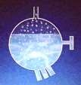
III. Priming and foaming
Foaming
It is the production of continuous foam or hard bubblers in boilers. Foaming is due to the presence of substance like oil in boiling water.
Priming
It is the process in which some particles in water are carried along with the steam. The resulting process is called as wet steam or carry over. The process of formation of wet steam in boilers is called as priming.
Foaming
Normal bubble
Priming
Carry over bubble
7

Slide 30
Causes of Priming
(1) the presence of large amount of dissolved solids
(2) high steam velocities.
(3) sudden boiling
(4) improper boiler design
(5) sudden increase in steam-production rate.
Disadvantages of Priming
(1) Dissolved salt in boiler water are carried out by the wet steam to turbine
blades - which reduces their efficiency.
(2) Dissolved salts may enter the parts of other machinery may decrease the life of the machinery.
(3) Actual height of the water column cannot be judge properly, Thereby
making the maintenance of the boiler pressure becomes difficult.
30

Slide 31
Prevention of Priming
(1) By improving boiler design.
(2) By fitting mechanical steam purifiers.
(3) By maintaining low water level in boilers
(4) By using soft water.
(5) By decreasing the amount of dissolved salts.
( B) FOAMING :
It is the production of foam or bubbles in boiler which do not break easily.
Causes of Foaming :
It is due to the presence of oily substances in water.
(1) Low level of water in boiler.
(2) The presence of dissolved salts in water.
(3) Sudden increase in steam production rate.
31

Slide 32
Disadvantages of foaming :
(1) Actual height of the water column cannot be judge.
(2) Dissolved salts in water carried by the wet steam may damage turbine blads or machinery parts.
(3) Boiler pressure cannot be maintained.
Prevention of Foaming :
(1) By the addition of anti-foaming chemicals like castor oil, Gallic
acid, tennic acid etc.
(2) removing oil from boiler water by adding compounds like sodium aluminate.
32

Slide 33
II . Softening of water/ External treatment of water – External
Conditioning of water
Softening of hard water can be done by the following methods
Lime soda process
Zeolite methods
Ion exchange resin method
Mixed bed deionizer method
1. Lime soda process
It is a process in which Lime (Ca(OH)₂) and soda (Na₂CO₃) are added to the hard water to convert the soluble calcium and magnesium salts to insoluble compounds by a chemical reaction. The CaCO₃ and Mg(OH)₂ so precipitated are filtered off and removed easily.
It is further divided in to two types
Cold lime soda process
Hot lime soda process

Slide 34
1. Cold lime soda process
Step 1
In this process a calculated quantity of Ca(OH)₂ (lime) and Na₂CO₃ (soda) are mixed with water at room temperature and added to the hard water. The following reactions takes place depending on the nature of hardness
Chemical reactions
If it is permanent hardness and due to calcium salt Ca²⁺ + Na₂CO₃ CaCO₃ + 2Na⁺ (soda)
slimy suspended precipitate
If it is due to Magnesium salt
Mg²⁺ + Ca(OH)₂ Mg(OH)₂ + Ca²⁺ (lime)
slimy suspended precipitate Ca²⁺ + Na₂CO₃ CaCO₃ + 2Na⁺ (soda)
slimy suspended precipitate

Slide 35
Chemical reactions contd..
If it is Temporary hardness and due to calcium salt Ca(HCO₃)₂ + Ca(OH)₂ 2CaCO₃ + 2H₂O
slimy suspended precipitate
If it is due to Magnesium salt Mg(HCO₃)₂ + 2Ca(OH)₂
2CaCO₃ + Mg(OH)₂ + 2H₂O
slimy suspended precipitates
Step 2
The precipitates CaCO₃ and Mg(OH)₂ are very fine and forms sludge like precipitates in the boiler water and are difficult to remove because it does not settle easily making it difficult to filter and the removal process. Finally reduces the efficiency of the boiler.
Therefore, it is essential to add small amount of coagulant (such as Alum, Aluminium sulfate, sodium aluminate etc) which hydrolyses to flocculent precipitate of Al(OH)₃ which entraps the fine precipitates.
35

Slide 36
36
8

Slide 37
When coagulants are added flocculation takes place followed by the formation of
flocculants.
NaAlO₂ + 2H₂O NaOH + Al(OH)₃
Coagulant
Flocculent- Gelatinous precipitate which entraps the fine precipitates of CaCO₃ and Mg(OH)₂
Al₂(SO₄)₃ + 3 Ca(HCO₃)₂ 2Al(OH)₃ + CaSO₄ + CO₂
Aluminium sulfate
Hard water sample
Flocculent- Gelatinous precipitate which entraps the fine precipitates of CaCO₃ and Mg(OH)₂
The Al(OH)₃ formed by the addition of coagulants initiates the process of flocculation and entraps the fine precipitates and becomes heavy. The heavier flocs then settles at the bottom and filtered off easily.

Slide 38
Method :
Raw water & calculated quantities of chemicals: from the top in to the inner vertical circular chamber.
There is a vigorous stirring & continuous mixing : softening of water take place.
Softened water comes into the outer co-axial chamber, it rises upwards.
Heavy sludge settles down & softened water reaches up.
Softened water : passes through a filtering media to ensure
complete removal of sludge.
Filtered soft water finally flows out continuously through the outlet at the top.
Sludge settling at the bottom of the outer chamber is drawn
off occasionally.
38

Slide 39
(ii) Hot lime-soda process:
Treating water with softening chemicals at a temp. of 80 to 150˚c. Process : operated close to the boiling point.
consists three parts:
reaction tank: in which raw water, chemicals & steam are mixed,
Conical sedimentation vessel : sludge settles down.
Sand filter : complete removal of sludge from softened water.
39

Slide 40
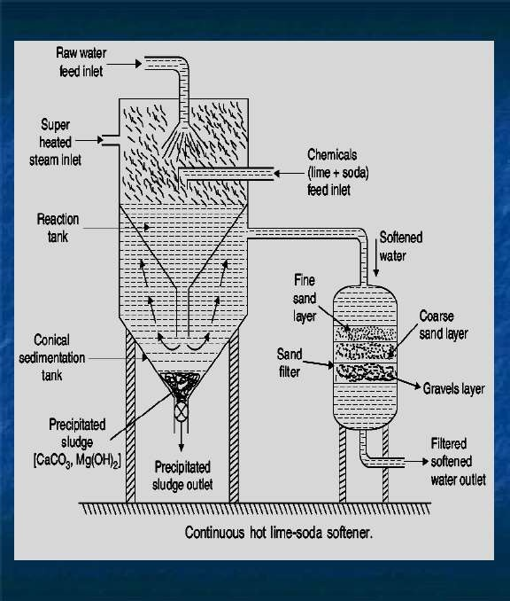
40
9

Slide 41
Advantages of hot lime-soda process:
The precipitation reaction is almost complete,
Reaction takes place faster,
Sludge settles down rapidly;
No coagulant is needed,
Dissolved gases (which may cause corrosion) are removed,
Viscosity of soft water is lower, hence filtered easily,
Residual hardness is low compared to cold lime-soda process.
41

Slide 42
Advantages of Lime – soda process:
1.Economical
2.Process increses pH value of the treated water, thereby corrosion of the distribution pipes is reduced.
3.Mineral content of water is reduced
4.pH of water raises thus reducing content of pathogenic bacteria
5. iron & Mn: removed.
Disadvantages of Lime – soda process:
1.Huge amount of sludge is formed and its disposal is difficult
2.Due to residual hardness, water is not suitable for high pressure boilers
42

Slide 43
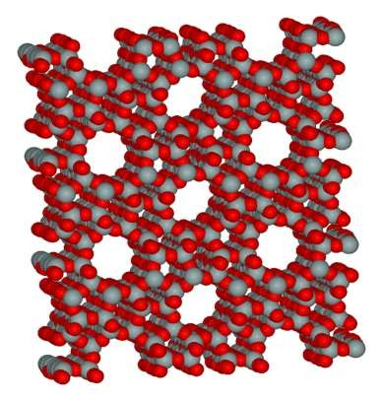
2. ZEOLITE OR PERMUTIT PROCESS:
Zeolite - hydrated sodium alumino silicate, capable of exchanging reversibly its sodium ions for hardness- producing ions in water.
The general chemical structure of Zeolite:
Na₂O.Al₂O₃.xSiO₂.yH₂O
(x = 2-10 and y = 2-6)
Micro pores of Zeolite
10
Porous structure of Zeolite
43

Slide 44
Two types:
Natural Zeolite: non-porous. e.g., Natrolite
Synthetic zeolite: porous & possess gel structure.
They are prepared by heating together china clay, feldspar and soda ash.
Zeolites possess higher exchange capacity per unit weight than natural zeolite.
44

Slide 45
Process:
Hard water is percolated at a specified rate through a bed of zeolite,
kept in a cylinder.
The hardness-causing ions are retained by the zeolite as CaZe and MgZe; while the outgoing water contains sodium salts.
To remove temporary hardness
Na₂Ze + Ca(HCO₃)₂ Na₂Ze + Mg(HCO₃)₂
CaZe + 2NaHCO₃ MgZe + 2NaHCO₃
To remove permanent hardness
Na₂Ze + CaCl₂ Na₂Ze + MgCl₂
CaZe + 2NaCl
MgZe + 2NaCl
45

Slide 46
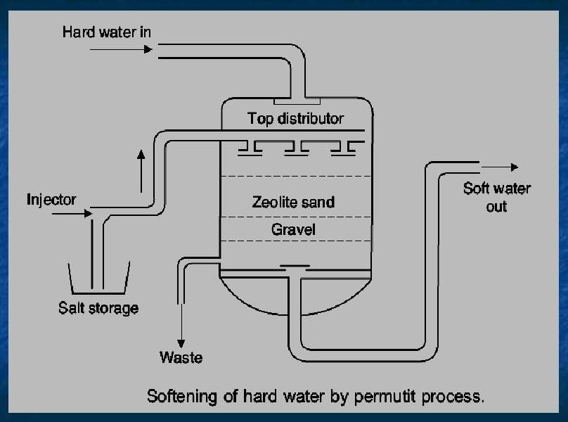
46 ₁₁

Slide 47
REGENERATION OF ZEOLITE:
At this stage, the supply of hard water is stopped and exhausted zeolite is reclaimed by treating the bed with concentrated NaCl solution.
CaZe or MgZe
(exhausted zeolite)
+ 2NaCl
(Brine)
Na₂Ze + CaCl₂
(Reclaimed zeolite) (washings)
47

Slide 48
LIMITATIONS OF ZEOLITE PROCESS:
If the water is turbid ---- then the turbidity causing particles
clogs the pores of the Zeolite and making it inactive
The ions such as Mn²⁺ and Fe²⁺ forms stable complex Zeolite which can not be regenerated that easily as both metal ions bind strongly and irreversibly to the zeolite structure.
Any acid present in water (acidic water) should be neutralized with soda before admitting the water to the plant, since acid will hydrolyze SiO₂ forming silicic acid
48

Slide 49
ADVANTAGES:
Residual hardness of water is about 10 ppm only
Equipment is small and easy to handle
Time required for softening of water is small
No sludge formation and the process is clean
Zeolite can be regenerated easily using brine solution
Any type of hardness can be removed without any modifications to the process.
DISADVANTAGES :
1. Soft water contains more sodium salts than in lime soda process
2. It replaces only Ca²⁺ and Mg²⁺ with Na⁺ but leaves all the other ions like HCO ⁻ and
3
CO ²⁻ in the softened water (then it may form NaHCO and Na CO which releases CO
3 3 2 3
when the water is boiled and causes corrosion)
2
3. It also causes caustic embitterment when sodium carbonate hydrolyses to give NaOH
49

Slide 50
ION EXCHANGE PROCESS:
Ion exchange resins are insoluble, cross linked, long chain organic polymers with a microporous structure, and the functional groups attached to the chain is responsible for the “ion-exchange” properties.
Acidic functional groups (-COOH, -SO3H, etc.) exchange H+ with other cations.
Basic functional groups (-NH2=NH etc.) exchange OH- with other anions.
50

Slide 51
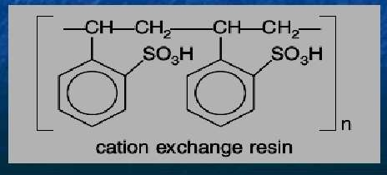
Classification of Resins
A. Cation-exchange Resins(RH+) : Strongly acidic (SO₃⁻H⁺) and weakly acidic (COO⁻H⁺) cation exchange resins
12
51

Slide 52
2. Anion Exchange resin (ROH⁻) – Strongly basic (R₄N⁺OH⁻)
and weakly basic (RNH₂⁺OH⁻) anion exchange resins
52
13

Slide 53
53
14

Slide 54
Process or Ion-exchange mechanism involved in water softening
Reactions occurring at Cation exchange resin
2 RH⁺ + Ca²⁺ (hard water) R₂Ca²⁺ + 2 H⁺
2 RH⁺ + Mg²⁺ (hard water) R₂Mg²⁺ + 2 H⁺
Reactions occurring at Anion exchange resin
2 ROH⁻ + SO₄²⁻ (hard water) R₂SO₄²⁺ + 2 OH⁻
2 ROH⁻ + Cl⁻ (hard water) R₂Cl⁻ + 2 OH⁻
At the end of the process
_{H}+
+ OH⁻ H₂O

Slide 55
Regeneration of ion exchange resins
Regeneration of Cation exchange resin
R₂Ca²⁺ + 2H⁺ (dil. HCl (or) H₂SO₄) 2 RH⁺ + Ca²⁺ (CaCl₂, washings)
Regeneration of Anion exchange resin
R₂SO₄²⁻ + 2OH⁻ (dil. NaOH) 2 ROH⁻ + SO₄²⁻ (Na₂SO₄, washings)
Advantages
The process can be used to soften highly acidic or alkaline waters
It produces water of very low hardness of 1-2ppm. So the treated waters by this method can be used in high pressure boilers
Disadvantages
The setup is costly and it uses costly chemicals
The water should not be turbid and the turbidity level should not be more
than 10ppm
5
5

Slide 56
IV. Softening of water by Mixed Bed deioniser
Description and process of mixed bed deionizer
It is a single cylindrical chamber containing a mixture of anion and cation exchange resins bed
When the hard water is passed through this bed slowly the cations and anioins of the
hard water comes in to contact with the two kind of resins many number of times
Hence, it is equivalent to passing the hard water many number of times through a series of cation and anion exchange resins.
The soft water from this method contains less than 1ppm of dissolved salts and hence
more suitable for boilers
Hard water
c
a
c a
a
Anion exchange resin
c Mixed bed
Mixed resin
bed
a
deionizer
a c
a
c
Cation exchange resin
c
Demineralised
water
56
15

Slide 57
1. When the bed (resins) are exhausted or cease to soften the water, the mixed bed is back washed by forcing the water from the bottom in the upward direction
Regeneration of mixed bed deionizer
Then the light weight anion exchanger move to the top and forms a upper layer above the heavier cation exchanger
Then the anion exchanger is regenerated by passing caustic soda solution (NaOH) from the
top and then rinsed with pure water
The lower cation exchanger bed is then washed with dil.H₂SO₄ solution and then rinsed.
The two beds are then mixed again by forcing compressed air to mix both and the resins are
now ready for use
NaOH
Low
density resin
c
a
c a
aa a a a a
c a _{a} c _{a}
c a
c a
c
c Mixed bed
c Exhausted
a
Back washed
Regenerated Mixed bed deionizer
a
a
a
deionizer
a
a
Mixed bed
a c
a
a c
a
c c c c c c
a _{c}
c
c
c
c
c
c
57
Back wash water
Compressed air
High density resin
16

Slide 58
DESALINATION OF BRACKISH WATER
Process of removing common salt from water.
Brackish water: water containing dissolved salts with a peculiar salty taste
Sea water : 3.5% salts. 1.Electrodialysis, 2.Reverse osmosis.
58

Slide 59
ELECTRO DIALYSIS
Principle:
Electrodialysis is an electrochemical process whereby electrically charged particles, ions, are transported from a raw solution (retentate, diluate) into a more concentrated solution (permeate, concentrate) through ion-selective membranes by applying an electric field.
59

Slide 60
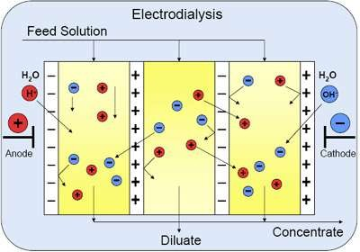
17
60

Slide 61
THEORY OF ELECTRODIALYSIS
Electro dialysis chamber comprises of sheet like barriers made out of high-capacity, highly cross-linked ion exchange resins that allow passage of ions but not of water.
There are two types : (a) Cation exchange and (b) Anion exchange membranes
Cation exchange membranes consists of an insoluble matrix and mobile cation reside in the pore space that allows the pass through of only cations.
Anion exchange membranes consists of an insoluble matrix and mobile anion
reside in the pore space that allows the pass through of only anions.
Cation- and Anion- exchange membranes are installed alternatively in the tank.
By impressing electricity on the electrodes, the positive anode attracts negative ions in solution, while the negative cathode attracts positive ions in the solution.
61

Slide 62
Na+ : negative pole,
Cl- : positive pole.
Concentration of brine decreases : central compartment.
It increases: two side compartment.
Desalinated brine : removed
Concentrated brine : replaced by fresh water.
Electrodialysis cell : consists of a large no. of rigid plastic membrane.
Saline water is passed & electric field is applied.
Positive charges : repel positive ions & permit negative ion.
Negative charges.
Water: deprived of its salts,
Salt concentration : increases in adjacent compartment.
62

Slide 63
Advantage:
Most compact unit,
Economical,
If electricity is easily available, it is best suited
63

Slide 64
REVERSE OSMOSIS:
When two solutions of unequal concentration are separated by a semi-permeable membrane, flow of solvent takes place from dilute to concentration side, due to increase in osmostic pressure, which is termed as osmosis.
However, when a hydrostatic pressure in excess of osmotic pressure is applied on the concentrated side, the solvent flow is reversed from concentrated side to dilute side, across the membrane. This principle is termed as reverse osmosis.
64

Slide 65
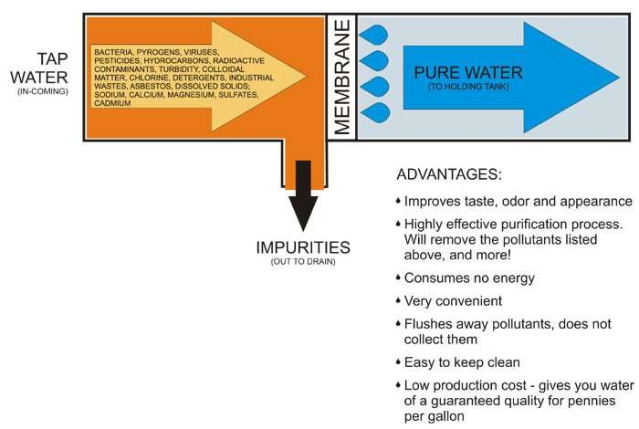
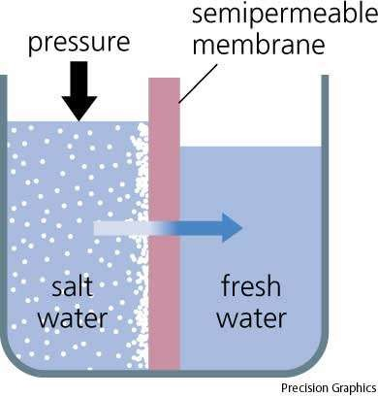
Reverse Osmosis
65
18

Slide 66
The semi-permeable membrane (in reverse osmosis) is selective in not permitting the passage of dissolved solute particles such as molecules, ions, etc.) It permits only the flow of water molecules (solvent) from the concentrated to dilute side.
Cellulose acetate, polyamide, etc., are used as membrane
Reverse osmosis process requires only mechanical force to
generate the required hydrostatic pressure.
66

Slide 67
POTABLE WATER
Water : safe to drink,
Fit for human consumption, should satisfy the following requirements:
Clear & odourless,
Pleasant in taste,
Perfectly cool,
Turbidity should not exceed 10ppm,
Free from objectionable dissolved gases
Objectionable minerals: lead,arsenic, Mn, Cr
7. pH:8.0
Reasonably soft,
Free from disease-producing microorganisms.
67

Slide 68
BREAK-POINT CHLORINATION
Involves in addition of sufficient amt. of chlorine to oxidise :organic matter, reducing substances.
Dosage of applied chlorine to water rich in organic compound or ammonia is gradually increased.
Four stages:
The addition of chlorine at the dip or break : ’ breakpoint’ chlorination.
This indicates the point at which free residual chlorine begins to appear.
All tastes, odour disappear at break point : water free from bad tastes and odours.
68

Slide 69
Persistent & powerful disinfection possessed by available free chlorine, any type of pathogenic organisms present : destroyed.
Advantages:
Oxidises completely organic compound, ammonia &
other reducing compound.
Removes colour
Removes disease producing bacteria
Removes odour & taste.
69

Slide 70
DE-CHLORINATION
Over-chlorination after the break point : produces unpleasant taste &
odour
Removed by filtering the over-chlorinated water through a bed of molecular carbon.
Activated C : added directly & after a short reaction period :
removed by filteration.
SO₂ / sodium sulphite / sodium thiosulphate.
SO₂ + Cl₂ + 2H₂O
Na₂SO₃ + Cl₂ + H₂O
H₂SO₄ + 2HCl Na₂SO₄ + 2HCl
70

Slide 71
REFERENCE:
Image 1: http://postimg.org/image/9dskyjsvj/
Image 2: http://postimg.org/image/3kawku281/
Image 3: http://postimg.org/image/ritblpo01/
Image 4: http://www.slideshare.net Image 5:http://www.slideshare.net
Image 6: http://postimg.org/image/rhjdsam69/
Image 7: http://postimg.org/image/d0w4dpwox/
Image 8: http://postimg.org/image/ficgyq5z5/
Image 9: http://postimg.org/image/c7o3yug1t/
Image 10: http://postimg.org/image/a82wtowch/
71

Slide 72
Image 11: http://postimg.org/image/sc5xebu0x/
Image 12: http://postimg.org/image/51wcwe6yp/
Image 13: http://postimg.org/image/dnzmgziyp/
Image 14: http://www.slideshare.net
Image 15:http://www.slideshare.net Image 16:http://www.slideshare.net
Image 17:http://postimg.org/image/p1m5s6thd/ Image 18:http://postimg.org/image/mqetl9cbr/
72

