Slide 1
Course: B.Tech.
Subject: Engineering Chemistry Unit: V (B)

Slide 2
DEFINITION: LUBRICANTS
A lubricant is substance (often liquid) introduced between two moving surfaces to reduce the friction between them.
Fluid which is introduced in between moving parts in order to reduce the friction, generated heat & wear and tear of machine parts are called Lubricants.
This process of introducing lubricant is called
Lubrication.

Slide 3
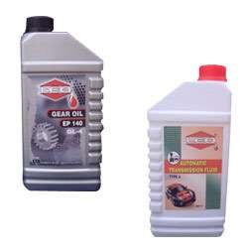
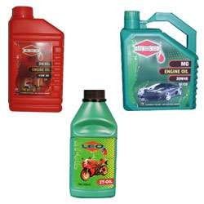
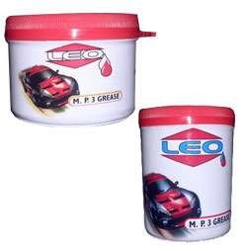
Gear and Transmission oils
Automotive Oils
Automotive Grease

Slide 4
COMPOSITION
Typically contains | 90% | base
oil(petroleum-mineral | oils) and | less
than 10% additives
Non liquid lubricants contains Grease,
powder(dry disulphite), plumbing etc.
graphite, Molybdenum Teflon tape used in
Those non liquid lubricants provide lubrication at higher temp.(up to 350
°C)

Slide 5
ADDITIVES USED IN
LUBRICANTS
Anti oxidant --- Aromatic amines,Phenols,Sulphides and phosphates
Corrosion Inhibitor --- Amino salts and salts of sulphonic acids
Antiwear agents --- Tricresyl phosphate
Foam inhibitors --- Glycerols

Slide 6
Functions of Lubricants
It acts as a thermal barrier and reduces friction and wear and prevents welded joints
Avoids seizure of moving surfaces
Acts as coolant
Acts as a seal and prevents entry of dust, moisture, & dirt between moving parts
Some lubricants acts as corrosion inhibitors thus reduce operational cost .

Slide 7
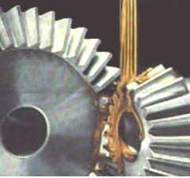
A good lubricating oil should
have:
High boiling point
Adequate Viscosity
Low freezing point
High oxidation resist
Non Corrosive properties
Good thermal stability
2

Slide 8
Types Of Lubrications
Thick Film
Thin Film or Boundary
or
Extreme Pressure Lubrication
Fluid Film
or
hydrodynamic
Lubrication
Lubrication

Slide 9
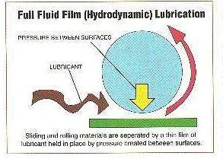
This is also called Hydrodynamic
or fluid film lubrication.
Two sliding metal surfaces are
•
separated from each other by a
thick film of fluid ( 1000 A
thick).
o
The coefficient of friction in such cases is as low as 0.001 to 0.03
Lubricants used : Hydrocarbon Oils.
Provided in delicate instruments such as watches, clocks, light machines like sewing machines, scientific instruments etc.

Slide 10
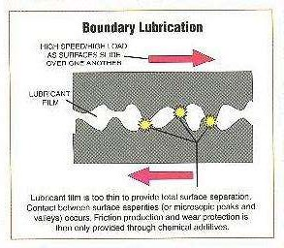
•
This lubrication is also called
Boundary Lubrication.
Its used for high load conditions. Very thin film of the lubricant is adsorbed on the surface by physical
or chemical forces or both.
The coefficient of friction is 0.05 to 0.15
Lubricants used for boundary
•
•
•
•
lubrication should have high viscosity index, resistance to heat and oxidation, good oiliness.
Examples are Organic oils, Vegetable oils, Graphite and MoS₂, Mineral Oils etc.
•

Slide 11
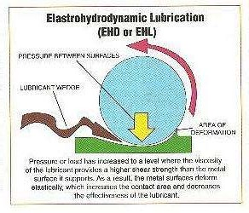
This lubrication is for very high
press/temp/speed sliding surfaces.
Extreme pressure additives are used along with the lubricants.
Chemicals used are compounds of
Cl, S & P.
These additives form solid surface films of Cl, S & P.
High melting point metal
compounds are good lubricants.
E.g. graphite is used for drawing wires made up of mild steel.
•
3

Slide 12
Classification of Lubricants
Liquid Lubricants
Semi Solid Lubricants
Synthetic Lubricants
Solid Lubricants
Eg.Mineral Oil,
Eg. Petroleum jellies
Eg. Graphite,
Petroleum Oil,
Molybdenum
Disulphide etc.
Vegetable Oil etc

Slide 13
TYPES OF LUBRICANTS
Solid lubricants e.g Wax, Talc, Mica, Molibdenum disulphide
Semi solid lubricants e.g. Grease and Vaseline
Liquid Lubricants e.g. Mineral oils, Vegetable oils, Animal oils
Synthetic lubricants e.g. Polyglycols, Silicones,
Organic amines, Imines, Amides.

Slide 14
FEATURES OF LUBRICANTS
Increase efficiency and reduce wear
Dissolving or transporting foreign particles and distributing heat
Single largest application is in form of Motor Oil, protecting internal combustion engines in motor vehicles and powered equipments
Another approach is to use ball bearings, roller bearing or air bearings which in turn require internal lubrication themselves

Slide 15
It’s a measure of a fluid’s resistance to flow.
Viscosity of the lubricating oil determines its performance under operating conditions.
A low viscosity oil is thin and flows easily .
A high viscosity oil is thick and flows slowly.
As oil heats up it becomes more viscous (Becomes thin)
Too low viscosity of the liquid > Lubricant film cannot be
maintained between the moving surfaces > Excessive wear.
Too high viscosity of the liquid > Excessive friction.
Selected Lubricant must be proper viscous.
Viscosity is usually expressed in centipoise or centistoke.

Slide 16
Iodine number is the number of Gms equivalent of iodine to amount of ICl absorbed by 100gm of oil.
Each oil has its specific Iodine Number.
So Iodine Number determines the extent of contamination of oil.
Low Iodine Number is desirable in oils.
Some oils and their Iodine Numbers are given below :
Iodine Number
Oil
Example
>150
Drying oil
Linseed oil, tung oil
100-150
Semidrying oil
Castor oil , Soyabean oil
<100
Non-Drying oil
Coconut oil, Olive oil

Slide 17
Aniline point is the Min temp at which oil is miscible with equal amt of
•
aniline
•
•
Aniline Point is a measure of aromatic content of the lubricating oil.
Low Aniline Point oil have high aromatic content which attacks rubber
seals.
•
•
Higher Aniline point means low %age of hydrocarbons (desirable).
Thus Aniline Point is used as an indication of possible deterioration of
rubber sealing etc.
Determination of Aniline Point :
Aniline +
Homogeneous solution
sample oil
Heated in Test tube
(equal)
Cooled
Cloudiness
The temperature at which separation of the two phases (Aniline + oil) takes place
is the Aniline Point.

Slide 18
Emulsification is the property of water to get mixed with water easily.
Emulsions can be oil in water emulsion or water in oil emulsion.
A good lubricating oil should form such an emulsion with water which breaks easily. This property is called demulsification.
The time in seconds in which a given volume of oil and water
separates out in distinct layers is called steam demulsification
number.
A good lubricating oil should have lower demulsification number.
Quicker the oil separates out from the emulsion formed, better is the lubricating oil.
In cutting oils the higher the emulsification number, better the oil is.
This is because the emulsion acts as a coolant as well as a lubricant.

Slide 19
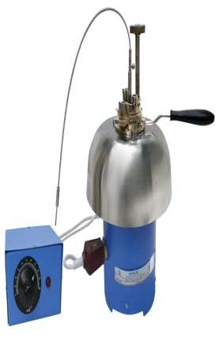
Flash Point is the min temp at which the lubricant vaporizes that ignite for a
•
moment when tiny flame is brought near.
•
Fire Point is the Min temp at which the lubricant’s vapours burn constantly for
5 seconds when tiny flame is brought near.
•
If flash point < 140°F = Flammable liquids
And if flash point > 140°F =Combustible liquids.
The flash and fire points are generally determined by using
Pensky-Marten’s apparatus.
Oil under examination is filled in the oil cup up to the mark and heated by the air bath by a burner.
Stirrer is worked b/n tests at a rate of about 1 – 2 rev/sec.
Heat is applied so as to raise the oil temp by about 5c/min.
The temp at which distinct flash appeared in side the oil cup
is recorded as flashpoint.
The heating is continued to record the fire point.
4

Slide 20
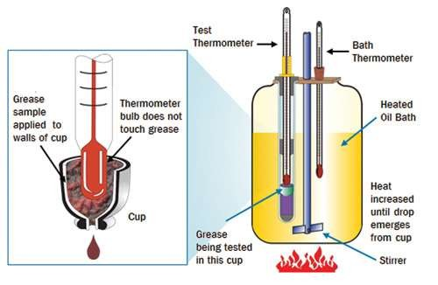
Drop Point is the Temperature at
•
which grease passes from the semi- solid to the liquid state. So, it determines the upper temp limit for the applicability of grease.
Determination :
•
•
•
Beaker is heated.
Temperature is raised.
Grease sample passes from a semi-
solid to a fluid state.
•
Temp at which its first drop falls
from the opening is recorded as
drop-point.
5

Slide 21
Cloud Point is the temp at which the lubricant becomes cloudy or hazy when cooled.
Pour Point is the temp at which the lubricant just ceases to flow when cooled.
Both indicates suitability of lubricant in cold conditions and thus must be low.

Slide 22
It’s the mgs of KOH required to saponify 1 gm of oil.
Saponification is hydrolysis of an Easter with KOH to give alcohol and Na/K salt of acid.

Slide 23
USES
Other uses are
for cooking,
biomedical applications on human(lubricants for
artificial joints).

Slide 24
APPLICATIONS
Automotive Industry-Engine oil, Automatic
transmission fluid, Gearbox fluid, Break fluids.
Tractor(One lubricant for all systems)
Other motors(2 stroke engine oil)
Industrial(Hydraulic oils, Air compressor oils, Gas Compressor oils, Gear oils Bearing and circulating system oils, Refrigerator compressor oils)
Aviation
Marine

Slide 25
REFERENCES
www.motosport.com
www.umongo.co.za
http://www.vidyarthiplus.in/2012/01/engineering-
chemistry1-lubricants.html#
www.aimil.com
www.machinerylubrication.com
A textbook of Engineering Chemistry by Shashi
chawla

