Slide 1
POLY PHASE INDUCTION MOTOR
.

Slide 2
Construction:
Induction motor consists essentially of two main parts
1. Stator
2. Rotor

Slide 3
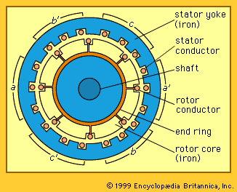
Fig: 3-φ induction motor: cross section

Slide 4
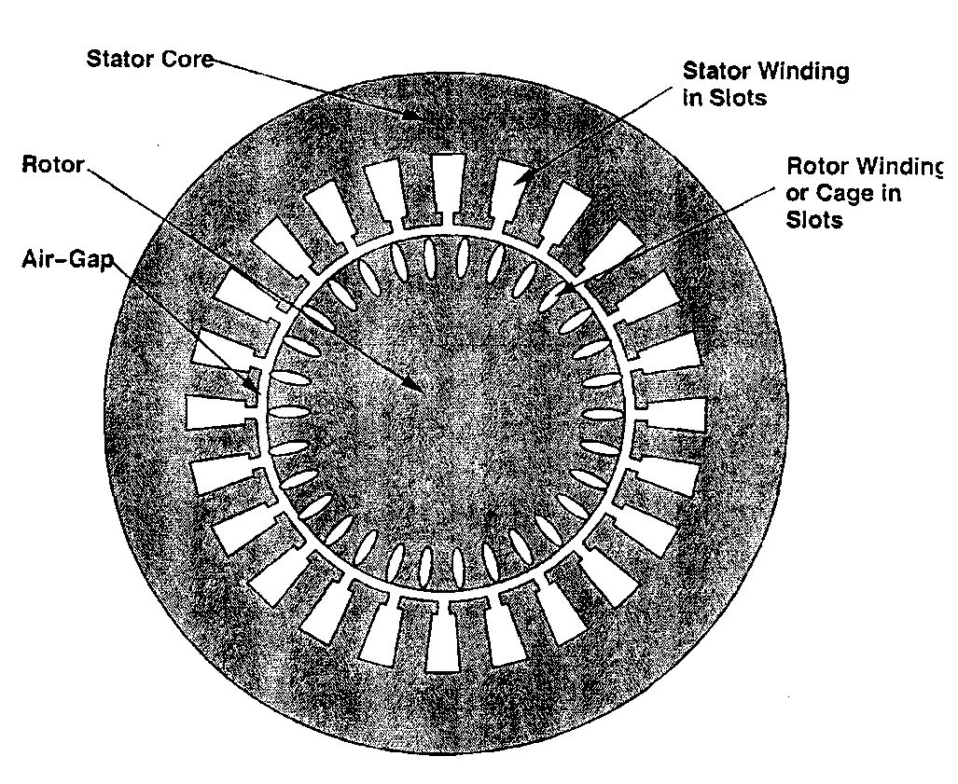

Slide 5
Stator:
The stator consists of a cylindrical laminated & slotted core placed in a frame of rolled or cast steel.
It carries a 3-phase winding and is fed from a 3-phase supply.
It is wound for a definite number of poses (determined by the requirement of speed).
Greater the number of poles, lesser the speed and vice versa.

Slide 6
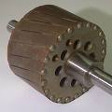
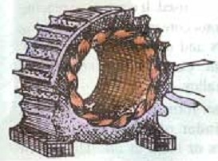
There are two general types of rotors: 1. Squirrel-cage rotor 2. ‘Phase wound’ or ‘wound’ or ‘slip ring’ rotor.
Rotor:
The rotor consists of a laminated & slotted core tightly pressed on the shaft.
Fig. Completely wound stator for an IM.
Fig. Rotor for an IM.

Slide 7
Squirrel-cage Rotor
The rotor consists of a cylindrical laminated core with parallel slots for carrying the rotor conductors which are not wires but consist of heavy bars of copper, aluminium or alloys.
One bar is placed in each slot.
The rotor bars are brazed or electrically welded or bolted to two heavy and stout short-circuited end-rings, thus giving us, what is so picturesquely called, a squirrel-case construction.

Slide 8
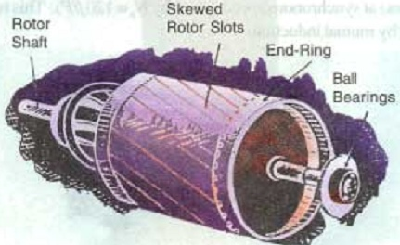

Slide 9
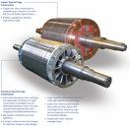
Q. Write down the significance of the name ‘squirrel-cage’ in case of squirrel-cage rotor. Phase wound Rotor (‘Phase wound’ or ‘wound’ or ‘slip ring’ rotor): This rotor is provided with 3-φ, double-layer, distributed winding. Q. what is the significance of wound rotor?

Slide 10
Contd.
The rotor is wound for as many poles as the umber of stator poles and is always wound 3-phase even when the stator is wound two-phase.
The three phases are starred internally. The other three winding terminals are brought out and connected to three insulated slip rings mounted on the shaft with brushes resting on them.
3 brushes are further externally connected to a 3 phase star-connected rheostat.

Slide 11
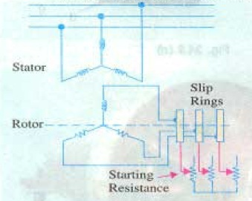
Starting Resistance of Slip ring motor

Slide 12
Production of Rotating Field: ( For 2-φ, and 3-φ supply)
(For 2- φ)
(For 3- φ)
B.L. Thereja. Art: 34.6 & 34.7

Slide 13
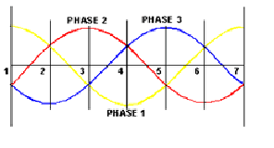
3-φ supply

Slide 14
Why does the Rotor Rotate?
3-φ stator winding is fed by 3-φ supply
Rotating flux of const. magnitude produced
Flux passes through air-gap & cuts rotor conductor
An emf is induced in rotor conductor
Since rotor bars or conductors from closed circuit, current flows through rotor conductors whose direction, as given
by Lenz’s law, is such as to oppose the very cause producing it.
In this case the cause of rotor current is the relative velocity between the rotating stator flux & the stationary rotor conductors.
Hence, to reduce the relative speed, the rotor starts running in the same direction as that of the flux and tries to catch up with the rotating flux.
Thus rotor of induction motor rotates

Slide 15
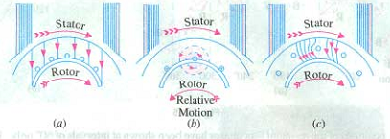
Contd.
Fig. Rotation of Rotor of an IM.

Slide 16
Write down the significance of the name “Induction Motor”.
In induction motor, no current is conducted to one of the motor element (field or armature).
The current in one of these elements results from an induced voltage and for that reason it is called Induction motor.
Induction motors are somewhat referred to as asynchronous(meaning not synchronous) machines.

Slide 17
Why induction motor treated as a rotating transformer?
Transformer has two sides: primary & secondary
Transformer transforms energy from primary to secondary by induction
Similarly, Induction motor has primary (stator) & secondary (rotor)
Voltage is induced in secondary by rotating flux of const. magnitude i.e the process of induction
Thus induction motor treated as a rotating transformer.

Slide 18
Slip
The difference between the synchronous speed N_{s} and the actual rotor speed N_{r} is known as slip. It is usually expressed as a percentage of the synchronous speed.
Sometimes, (N_{s} - N_{r}) is called the slip speed.
So, the rotor speed Nr = Ns(1-s)

Slide 19
Frequency of Rotor Current
When the rotor is stationary, the frequency of rotor current is the same as the supply frequency.
But when the rotor starts revolving, then the frequency depends upon the relative speed or on slip-speed.
Let at any slip speed, the frequency of the rotor current be f’. Then,
Dividing one by the other, we get,
So rotor current frequency is f’ =sf

Slide 20
Power Stages in an Induction Motor
Motor input in stator, P₁
Mechanical power developed
in Rotor,
P_{m}
Rotor input,P₂
Rotor cu & core losses
Stator cu & core losses
Rotor output, P_{out}
Friction and windage Loss
B.L Thereja; Art: 34.34

Slide 21
Problems
1. A 4-pole, 3-phase induction motor operates from a supply whose frequency is 50 Hz. Calculate:
The speed at which the magnetic field of the stator is rotating.
The speed of the rotor when the slip is 0.04.
The frequency of the rotor currents when the slip is 0.03.
The frequency of the rotor currents at standstill. [ Example: 34.3]
2. An 8-pole alternator runs at 750 r.p.m and supplies power to a 6-pole induction motor which has at full-load a slip of 3%. Find the full-load speed of the induction motor and the frequency of its rotor e.m.f. [ Tutorial: 34.1/3]
In the case of an 8 pole induction motor, the supply frequency was 50 Hz and the shaft speed was 735 rpm. Find out i) synchronous speed, ii) speed of slip
iii) per unit slip iv) percentage sleep. [ Tutorial: 34.1/1]
4. Example 34.4 (H.W)

Slide 22
Relation between Torque and Rotor Power factor
For dc motor we know that, torque T_{a}∞ Φ I_{a}.
Similarly in the case of induction motor, the torque is proportional to the product of flux per stator pole & rotor current. However there is one more factor that has to be taken into account i.e. the power factor of the rotor current.
Therefore, T∞Φ I₂cos Φ₂ => T=kΦ I₂cos Φ₂
Where, I₂= rotor current at standstill
Φ₂= angle between rotor emf and rotor current.
k= constant.

Slide 23
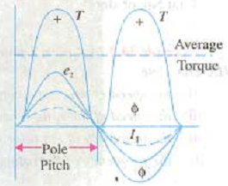
Contd.
Denoting rotor emf at standstill by E₂ , we have T∞E₂I₂cos Φ₂
Or, T=k₁E₂I₂cos Φ₂
Where, k₁ is another constant. And
The effect of rotor power factor is Shown in fig below. We get that if Φ₂ increases the torque decreases And vice versa.
Fig. shows the torque assuming resistive rotor.

Slide 24
Starting Torque
Torque developed at the instant of running is called starting torque.

Slide 25
Contd.

Slide 26
Condition For Maximum Starting Torque
It can be proved that starting torque is maximum when rotor resistance equals rotor reactance.

Slide 27
Starting Torque of Squirrel- Cage Motor
Resistance is fixed & small compared to the reactance
Frequency equals to supply frequency at starting
impedance small, current I₂ is large & lags by a very large angle behind E₂
For large power factor angle, the power factor becomes very low.
Hence Starting torque will be small
This motor is not useful where the motor has to start against heavy loads.

Slide 28
Starting Torque of Slip-ring Motor
By improving power factor, starting torque increase
Adding external resistance in rotor circuit from star connected rheostat, impedance increase
impedance Z₂ large, current I₂ is small
Current I₂ lags by small angle behind E₂
For low power factor angle, power factor becomes large.
So, starting torque will be large
This motor is useful where the motor has to start against heavy loads.

Slide 29
Effect of Change in Supply Voltage on Starting Torque
We know that
Now
Therefore
Where k₃ is yet another constant.
Hence
Clearly, the torque is very sensitive to any changes in the supply voltage. A change of 5% in supply voltage, for example, will produce a change of approximately 10% in the rotor torque.

Slide 30
Rotor EMF and Reactance Under Running Conditions
Let E₂= Standstill rotor induced e.m.f./phase
X₂ = Standstill rotor reactance/phase,
f₂ = rotor current frequency at standstill
When rotor is stationary then slip s=1 and frequency of rotor e.m.f. is same that of stator supply frequency.
Under running condition, rotor e.m.f. E_{r} = sE₂
Frequency of the induced emf f_{r} =sf₂
Due to the decrease in frequency of the rotor emf, the rotor reactance X_{r}=sX₂

Slide 31
Torque Under Running Condition

Slide 32
Contd.
C
Z₂
sX₂
Φ₂
A
B
R₂

Slide 33
Condition for maximum Torque Under Running Conditions

Slide 34
Contd.
Slip corresponding to maximum torque is
So, maximum torque from equation (1) is

Slide 35
Relation Between Torque and Slip
A family of torque/slip curves is shown in fig.1 below for a range of s=0 to s=1 with R₂ as the parameter. We know that
When s=0, T=0, hence the curve starts from point 0.
At normal speeds, close to synchronism, the term (sX₂) is small and hence negligible w.r.t. R₂.

Slide 36
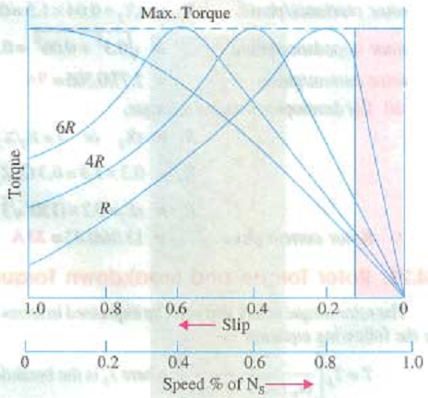
Contd.
For low value of s, the curve is approx. a straight line.
As s increases (for increasing motor load),
the torque increases and becomes maximum at s=R₂/X₂. This torque is known as “pull-out” or “breakdown” torque or, stalling torque.

Slide 37
Contd.
As the slip is increased further, R₂ becomes negligible as compared to (sX₂). Thus for large value of slip
Beyond the point of T_{max} , any further increase in motor load results in decrease of torque developed. Thus the motor slows down and eventually stops.
The stable operation of the motor lies between the values of s=0 and that corresponding to maximum torque as shown by the orange shaded region.

Slide 38
Effect of Change in Supply Frequency on Speed & Torque
The major effect of change in supply frequency is on motor speed
If frequency drops by 10%, speed also drops 10%
If machine tools & motor-driven equipment for 50 Hz supply connected to 60 Hz supply;
Then; everything runs = 20% faster than the normal.
In such case, we have to use either gears to reduce motor speed or an expensive 50 Hz source

Slide 39
How can a 50 Hz motor operate satisfactory on 60 Hz supply?
The condition for operating a motor in any supply frequency is should be constant at all times.
When a 50 Hz motor is operated on 60 Hz supply frequency then its terminal voltage is increased to =120% of rated supply

Slide 40
How can a 60 Hz motor operate satisfactory on 50 Hz supply?
The condition for operating a motor in any supply frequency is should be constant at all times.
When a 60 Hz motor is operated on 50 Hz supply frequency then the speed will decrease 16.66 %.
To operate the motor satisfactorily its terminal voltage is reduced to =83.33% of rated supply

Slide 41
Relation Between Full-Load Torque & Maximum Torque
T_{f} =
T_{max} =
If,

Slide 42
Relation Between Starting Torque & Maximum Torque
If,
Math: B.L Thereja; Example: 34.15(a), 34.16, 34.24 (V.V.I)

Slide 43
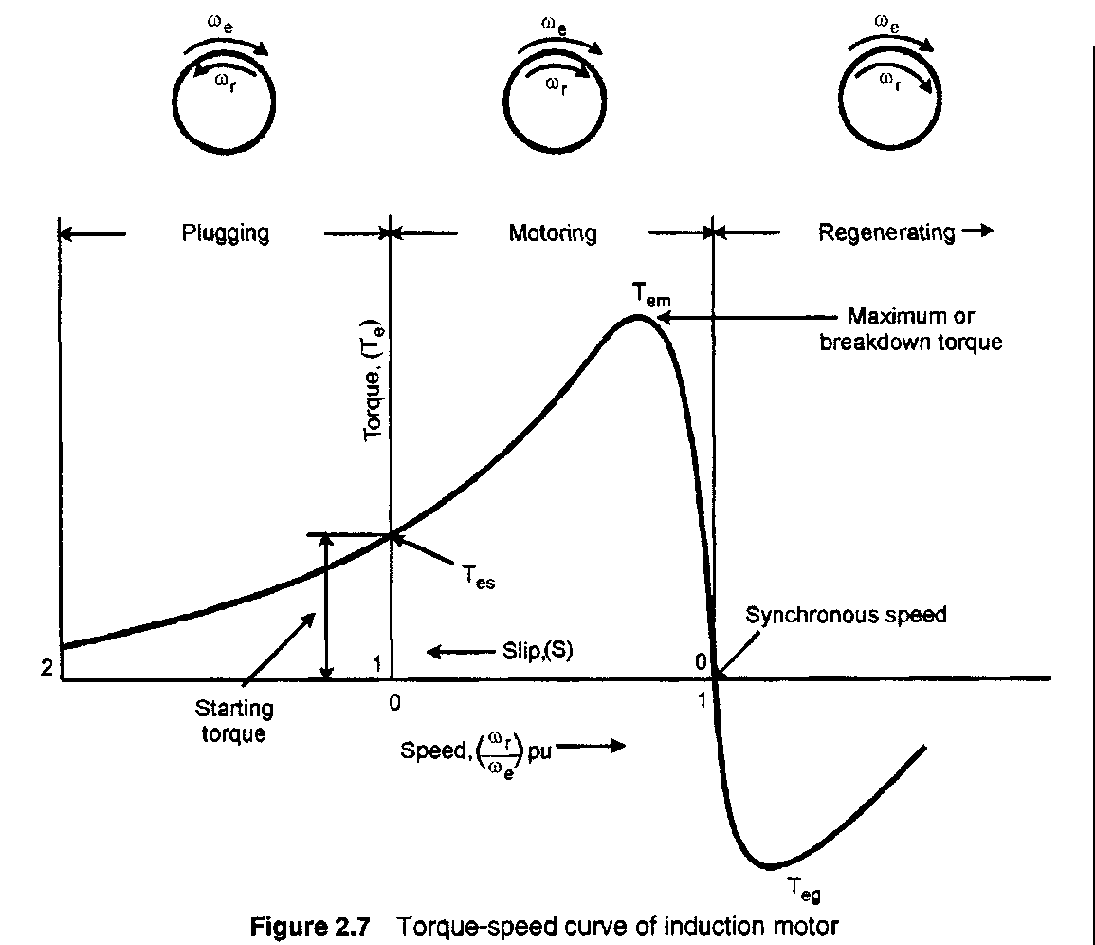
Torque-Speed Curve

Slide 44
Three regions in torque-speed curve:
1) Plugging (braking) region (1<s<2)
Rotor rotates opposite to direction of air gap flux. Can happen, for example, if stator supply phase sequence reversed while rotor is moving.
2) Motoring region (0<s<1)
T_{e}=0 at s=0. As s increases (speed decreases),T_{e} increases until max. torque (breakdown) is reached. Beyond this point, T_{e} decreases with increasing s.
3) Regenerating Region (s<0)
Here the induction machine acts as a generator. Rotor moves faster than air gap flux resulting in negative slip.

Slide 45
Plugging of an Induction Motor
An induction motor can be quickly stopped by simply interchanging any of its two stator leads.
It reverses the direction of the revolving flux which produces a torque in the reverse direction, thus applying brake on the motor.
This procedure of quickly stopping of induction motor by changing supply leads is called plugging of an induction motor.

Slide 46
Starting of Induction Motors
A plain Induction motor is similar in action to a polyphase transformer.
So it takes high current (almost 5 to 7 times of full load current while starting.

Slide 47
Methods for starting of Induction motors
Squirrel Cage Motor
Primary Resistors (or, rheostat) or reactors
Auto Transformer (or autostarter
Star-Delta Switches
For Slip ring motor
- Rotor Rheostat

