Slide 1
REGENERATIVE BRAKING IN MASS TRANSIT By Ch. Sai Ram, Assoc.Professor,
Sri Indu College of Engineering & Technology.

Slide 2
Outline
Introduction
Theory
Brake controller
Opportunities of regenerative braking
Challenges of regenerative braking
Energy storage systems
Existing implementation
Conclusion

Slide 3
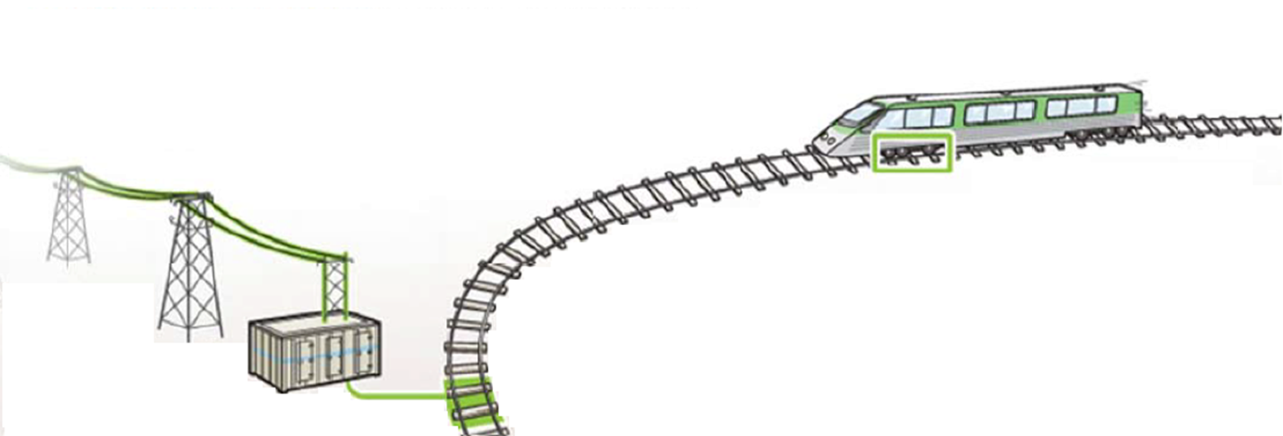
Regenerative Braking
An energy recovery mechanism which slows down a vehicle
Converted energy can be utilized immediately, stored, or sent back to the electric grid
Not new technology

Slide 4
Theory
How regenerative braking works:
Reversal process: cut power to the motor
Wheels turn motor and generate power
Regenerative brakes initiated
*Substantially more beneficial the more a train stops
Kinetic energy recoverable from regenerative braking:

Slide 5
Brake Controller
Fundamental to regenerative braking functioning properly
Remote control
Determines initiation, termination, and duration of braking
Monitors speed and calculates the torque available to generate electricity
Most imperative: determining if the motor can handle the force necessary to bring the vehicle to a halt
Where T_{R} is the rotational torque, i is the continuously variable transmission speed ratio, N is the final reduction gear ratio, T_{REG} is the regenerative torque by the motor, η is the generation efficiency, and W₁ and W₂ are weight factors

Slide 6
Opportunities For Regenerative Braking
Lengthened brake life: lowers maintenance and costs
Effective in AC locomotives
Increased energy and environmental awareness
Air Quality
Energy Efficiency
SO₂
CO₂
NO_{x}
Meet regulatory requirements

Slide 7
Challenges for Regenerative Braking
Regenerative braking must be used in conjunction with other brakes
Backup brakes in the event of failure
Battery and capacitor charge limitations
Not 100% reliable
Still a loss of energy
Less effective in DC locomotives

Slide 8
Energy Storage Systems
Battery Storage
Longer battery usage before recharging
Completely electric application
Ultracapacitor Storage Systems
Designed small to reduce wavering
Multiple applications
Flywheel Energy Storage
Momentum rotation
Vehicle runs smoothly
Extra weight from heavy metal rim
Stores energy for a long time
Superconducting Magnetic Energy Systems
Multiple benefits
Rarely used
Virtually unavailable for regenerative braking right now

Slide 9
Existing Implementation
High speed train applications have surfaced in Japan, France, India, New Zealand, England and Germany
A Northeastern transportation company in the United States has seen a huge success from regenerative braking implementation
$900,000 state grant and $1.44 million grant from FTA
An intercity passenger train service in the United States received 70 high-efficiency electric trains destined for routes across DC, Massachusetts, New York, and Pennsylvania
Multiple other applications in the Western United States

Slide 10
Conclusion
Increased interest in regenerative braking
Technology is available and useful
Multiple benefits
Few challenges
Energy storage methods can be utilized

Slide 11
Thank you!

